Slide 1
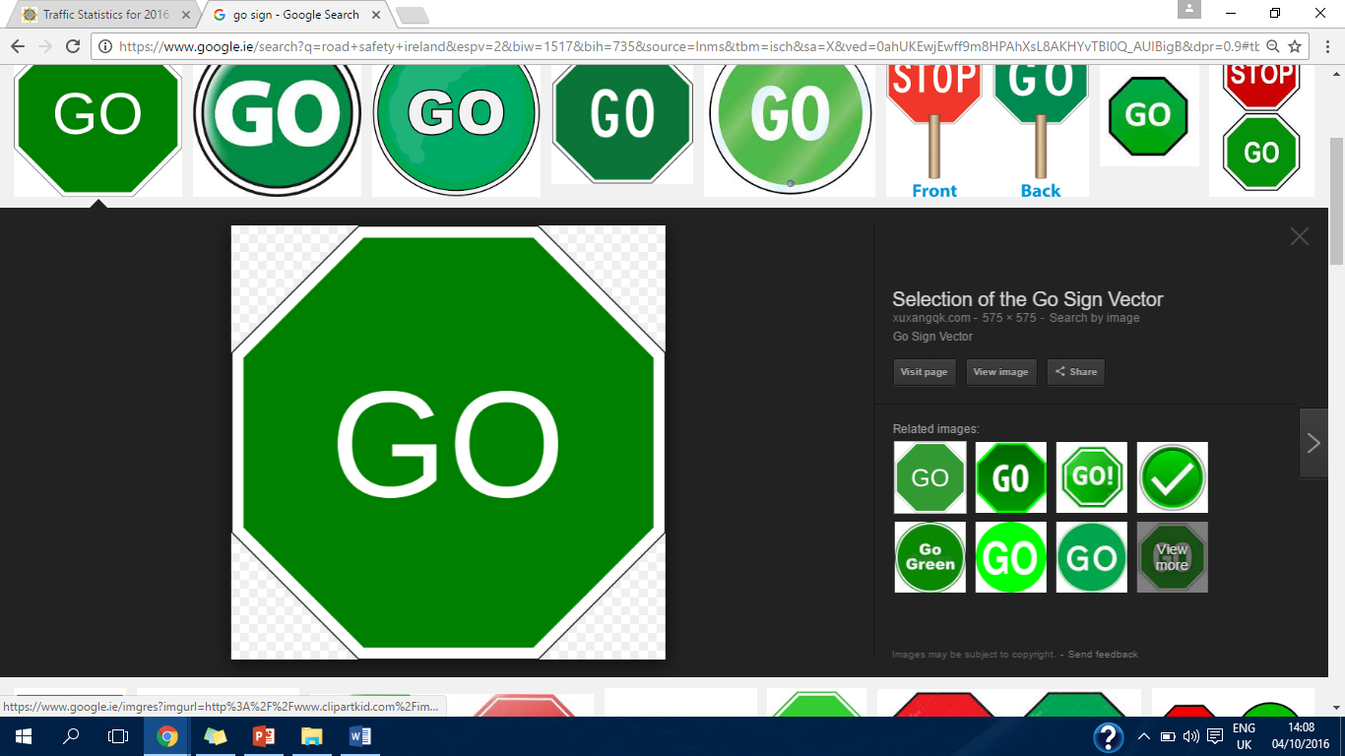
Road deaths in an Irish context,
What are the issues?
By: Leah Brennan

Slide 2
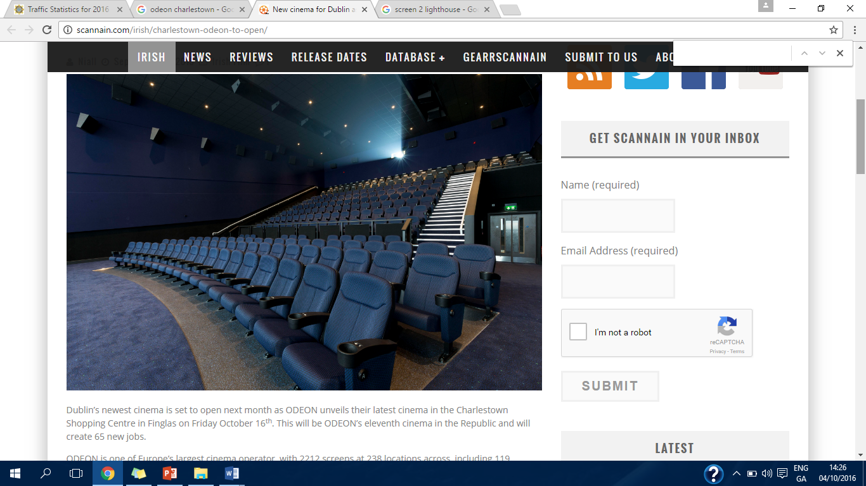
169
Notes:
2012
2015
As of 14:10 06.10.16

Slide 3
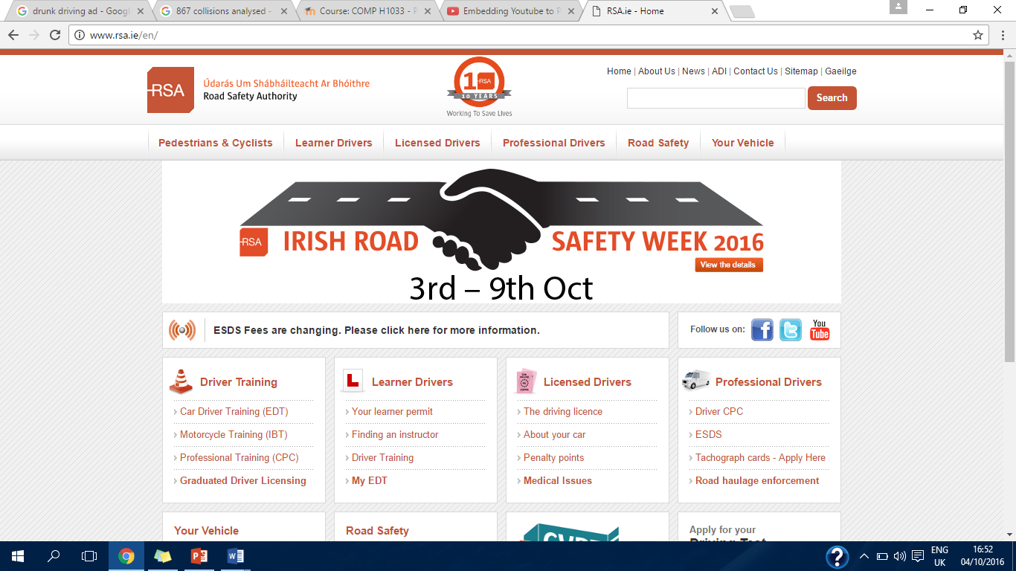
Questions?

Slide 4
References
The AA (2016) Young Drivers [online] available from: http://www.theaa.ie/aa/motoring-advice/driving-advice/younger-drivers.aspx (last accessed 06 Oct 2016).
Calnan D. and Kelly L. (2016) Week of road carnage continues as man dies after being struck by truck [online article] independent.ie, 08 Sept. 2016, available from http://www.independent.ie/irish-news/week-of-road-carnage-continues-as-man-dies-after-being-struck-by-truck-35032013.html (last accessed 06 Oct 2016).
Dublin InQuirer (2015) Bicycle Collision Tracker Identifying Dangerous Intersections [online] available from: http://www.dublininquirer.com/2015/10/20/bicycle-collision-tracker/ (last accessed 06 Oct 2016).
Fitzgerald C. (2016) Two women die in single vehicle crash in Donegal [online article] thejournal.ie Sept. 21st 2016, available from: http://www.thejournal.ie/women-death-donegal-2990410-Sep2016/ (last accessed 06 Oct 2016).
Garda.ie (2016) Traffic Statistics for 2016 [online] available from: http://www.garda.ie/Controller.aspx?Page=16418&Lang=1 (last accessed 06 Oct 2016).
Heneghan C. (2016) An incredibly dangerous driving habit amongst young drivers has been causing concern in Donegal [online article] JOE.ie June 2016 available from: http://www.joe.ie/motors/an-incredibly-dangerous-driving-habit-amongst-young-drivers-has-been-causing-concern-in-donegal/536949 (last accessed 06 Oct 2016).
Hennessy M. (2016) ‘It has destroyed the lives of five families’: 24 hours of tragedy on Donegal’s roads [online article] thejournal.ie, July 30th 2016, available from: http://www.thejournal.ie/donegal-road-deaths-2902078-Jul2016/ (last accessed 06 Oct 2016).
Ryan Ó. (2016) Alcohol a factor in almost one third of fatal motorcycle crashes [online article] thejournal.ie, 03 Oct 2016, available from: http://www.thejournal.ie/road-safety-motorcycling-3007685-Oct2016/ (last accessed 06 Oct 2016).
MasterofHealthAdministration.com (2013) 10 Powerfully Creative Anti-Drunk Driving Ads [online image] available from: http://www.master-of-health-administration.com/10-powerfully-creative-anti-drunk-driving-ads/ (last accessed 06 Oct 2016).

Slide 5
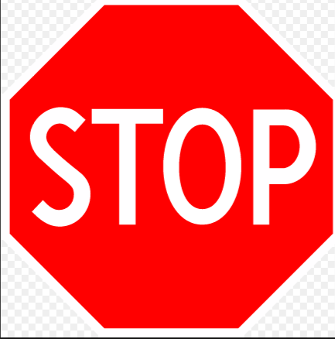
Melia P. (2016) The shocking figures behind drink-driving in Ireland, independent.ie, 28/06/2016 [online] available from: http://www.independent.ie/irish-news/revealed-the-shocking-figures-behind-drinkdriving-in-ireland-34839416.html (last accessed 06 Oct 2016).
RSA.ie (2016) Collision Statistics [online] available from: http://www.rsa.ie/en/RSA/Road-Safety/Our-Research/Collision-Statistics/ (last accessed 06 Oct 2016).
RSA.ie (2015) Deaths and Injuries on Irish Roads [online] available from: http://www.rsa.ie/RSA/Road-Safety/Our-Research/Deaths-injuries-on-Irish-roads/ (last accessed 06 Oct 2016).
RSA.ie (2016) Drink-Driving [online] available from: http://www.rsa.ie/RSA/Road-Safety/Campaigns/Current-road-safety-campaigns/Drink-Driving/ (last accessed 06 Oct 2016).
RSA.ie (2015) 2015 News; Road Deaths Rise for Second Consecutive Year [online] available from: http://www.rsa.ie/en/Utility/News/2015/Road-Deaths-Rise-For-Second-Consecutive-Year/ (last accessed 06 Oct 2016).
RSA.ie (2015) The government’s fourth Road Safety Strategy 2013-2020 [online] available from: http://www.rsa.ie/en/Utility/About-Us/Our-strategy/ (last accessed 06 Oct 2016).
Selection of the Go Sign Vector (2016) [online image] available from: http://xuxangqk.com/content/go-sign-vector.html (last accessed 06 Oct 2016).
Tispol.org (2016) Project Edward; European Day without a Road Death; #ProjectEdward [online] available from: https://www.tispol.org/Edward (last accessed 06 0ct 2016).
Thank you for listening.

